Slide 1
Digital Portfolio
STUDENT NAME: RASHVANDH A
REGISTER NO AND NMID: 2428C0504 & 53FE8BB1FEF0BD792A840BEFD7E951D4
DEPARTMENT: B.Sc - AIML
COLLEGE: KPR COLLEGE/ BHARATHIYAR UNIVERSITY

Slide 2
PROJECT TITLE
Startup Founder Portfolio

Slide 3


AGENDA
Problem Statement
Project Overview
End Users
Tools and Technologies
Portfolio design and Layout
Features and Functionality
Results and Screenshots
Conclusion
Github Link
3/21/2024 Annual Review

Slide 4

PROBLEM STATEMENT
Startup founders often struggle to present their journey, product vision, and achievements in a way that is both professional and impactful. Relying on pitch decks, LinkedIn profiles, or scattered documents fails to provide a centralized, dynamic view of their startup’s story and progress. This makes it harder to impress investors, attract top talent, build trust with partners, and stand out in a highly competitive ecosystem. Without a structured, visually engaging portfolio, valuable opportunities may be lost, and maintaining consistent communication with stakeholders becomes time-consuming and inefficient.

Slide 5

PROJECT OVERVIEW
Centralized Profile – A single platform to present the founder’s journey, startup vision, and achievements. Professional Branding – Builds trust and credibility with investors, partners, and accelerators. Milestone Tracking – Showcases product progress, market traction, and growth metrics in one place. Team & Culture Highlight – Introduces the core team and company culture to attract talent. Funding & Partnership Ready – Makes it easy for investors and strategic partners to understand value and alignment.

Slide 6

WHO ARE THE END USERS?
Investors – looking to understand the founder’s background, vision, and credibility before investing. Potential Co-Founders or Team Members – evaluating the founder’s skills, experience, and mission alignment. Clients or Early Adopters – interested in the company’s offerings and the founder’s track record. Mentors and Advisors – assessing the founder’s journey to provide guidance or partnerships. Media & PR Teams – gathering founder information for articles, interviews, or features.

Slide 7

TOOLS AND TECHNIQUES
HTML CSS JavaScript GitHub VS Code

Slide 8
POTFOLIO DESIGN AND LAYOUT
Header → Name, Title, Startup Logo Intro Section → One-liner about who you are and what your startup does About Me → Short background, vision, mission Projects / Startup Info → Key products, achievements, milestones Team → Core members, advisors (optional) Future Plans / Roadmap → What’s next for the startup (attracts investors and collaborators) Contact → Email, phone, LinkedIn, website Footer → Social media links, copyright
8

Slide 9
FEATURES AND FUNCTIONALITY
Clean Navigation → Easy-to-use menu for smooth browsing Responsive Design → Works on mobile, tablet, and desktop Quick Intro Section → Highlights founder and startup at a glance Projects & Achievements Showcase → Displays products, milestones, and impact Downloadable Pitch Deck / Resume → For investors or partners to access easily Contact & Networking Tools → Email form, LinkedIn, Calendly links Roadmap / Future Vision Section → Shows upcoming plans and goals

Slide 10
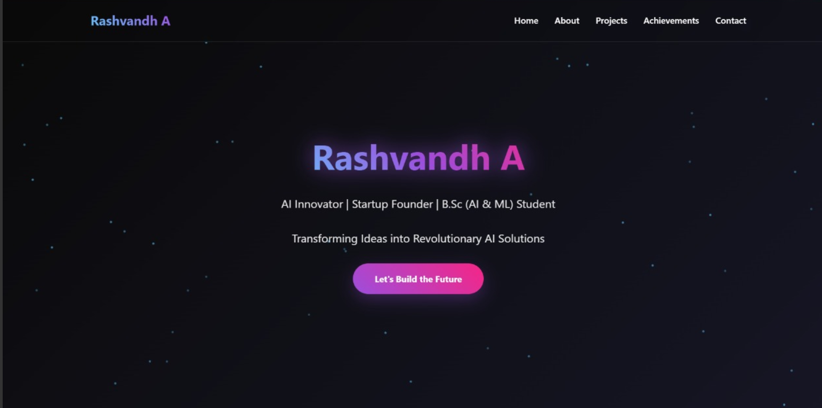

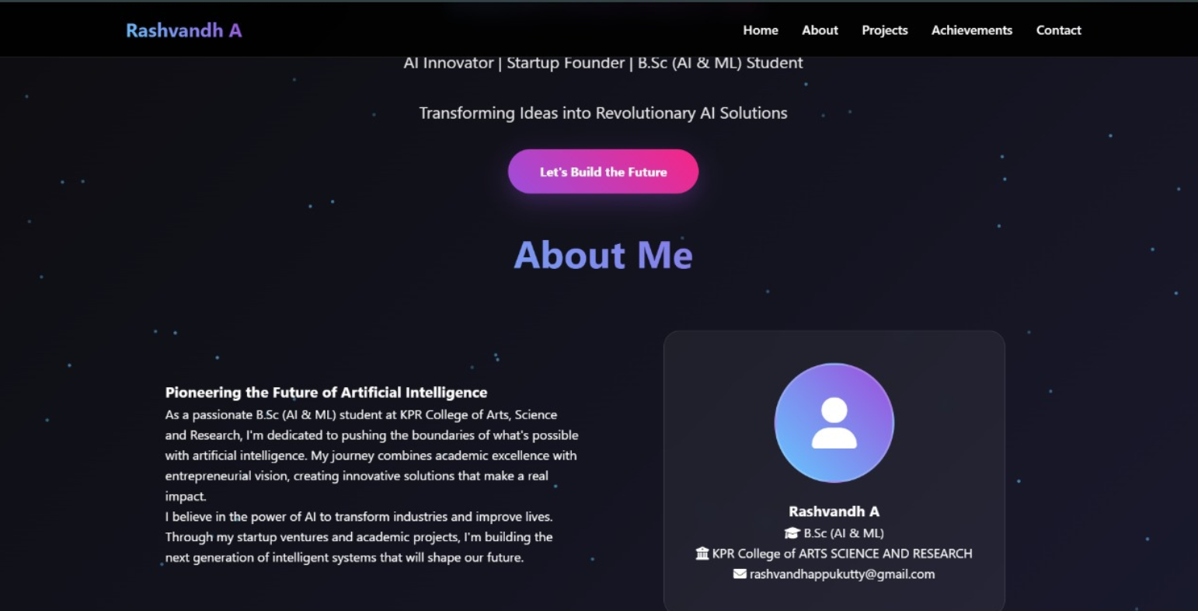
RESULTS AND SCREENSHOTS
3/21/2024 Annual Review
10

Slide 11
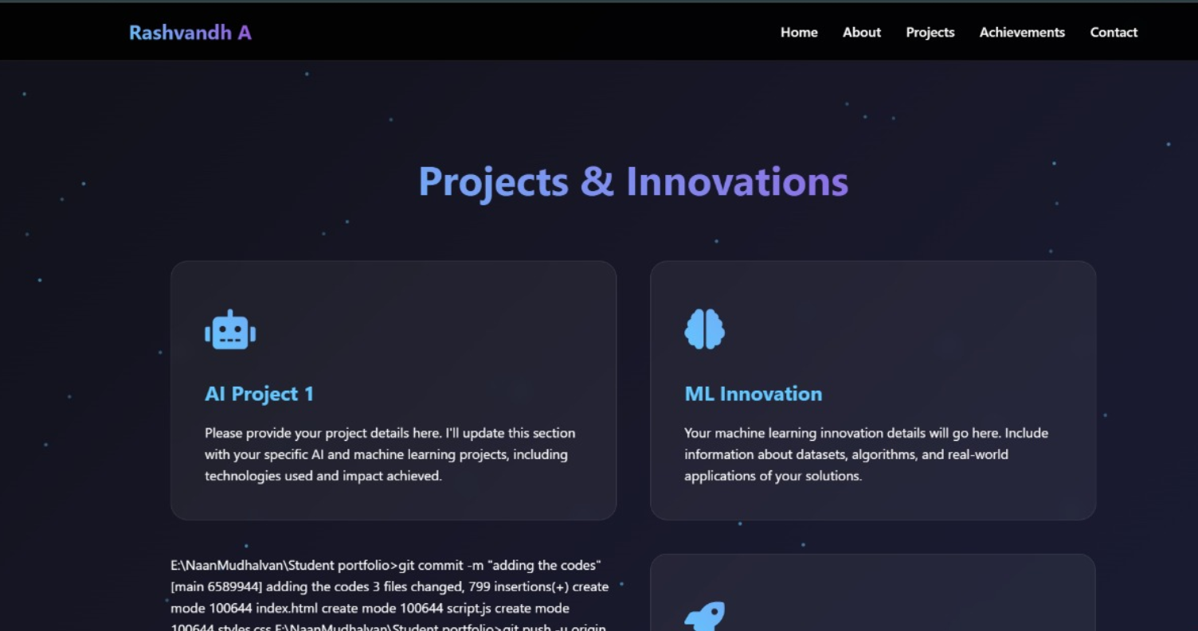
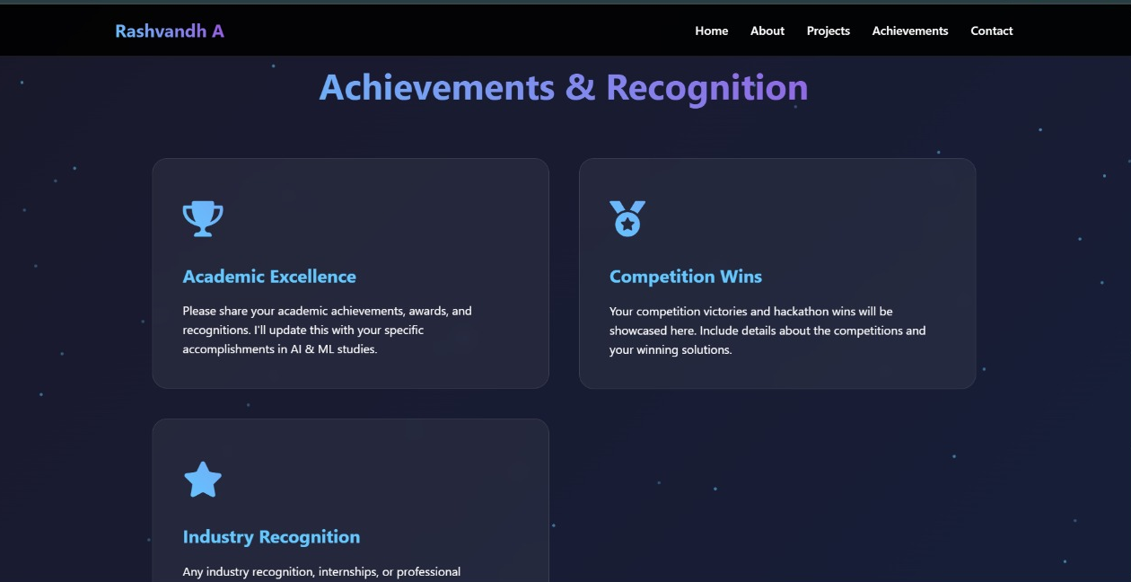
RESULTS AND SCREENSHOTS
3/21/2024 Annual Review
11

Slide 12
GITHUB LINK
https://github.com/rashvandhappukutty

Slide 13
CONCLUSION
A Startup Founder Portfolio is more than just a personal website — it’s a strategic tool. It brings together a founder’s journey, expertise, and startup vision in a clear, credible, and visually engaging way. By showcasing background, key projects, achievements, and future goals, it helps investors quickly understand potential, partners evaluate alignment, and collaborators see the value of joining forces. Whether viewed by mentors, incubators, media professionals, or customers, it communicates professionalism, readiness, and ambition.
13

